Slide 1
HOTEL RESERVATION ANALYSIS WITH SQL
RAJA ISRAR AZAM KIANI
Data Analysis Project

Slide 2
TABLE OF CONTENTS
01
02
03
PROBLEM & SOLUTION
OUR PROCESS
TARGET
Problem: Data-driven decision-making to enhance guest experience and operational efficiency
Solution: Using SQL to analyze hotel reservation data and extract insights for better decision-making.
Data Collection
SQL Query Formulation
Data Analysis and Reporting
Primary: Hotel managers and decision-makers
Secondary: Marketing teams and data analysts

Slide 3
Brief Introduction to the Dataset
Dataset Columns:
Booking_ID | no_of_adults
no_of_children | no_of_weekend_nights
no_of_week_nights | type_of_meal_plan
room_type_reserved | lead_time
arrival_date | market_segment_type
avg_price_per_room | booking_status

Slide 4
KEY POINTS OF DATASET
The dataset includes comprehensive information on hotel reservations
It covers guest demographics, booking details, and financial aspects
This rich dataset enables a thorough analysis of booking patterns and guest preferences

Slide 5
QUERY EXECUTION PROCESS
PROBLEM
RESULT
STEP 02
STEP 04
STEP 01
STEP 03
QUERY
INTERPRETATION
The question being addressed
The result of SQL query
The SQL query used to find the answer
Brief interpretation of the result

Slide 6
QUERY
01
What is the total number
of reservations in the Hotel?

Slide 7
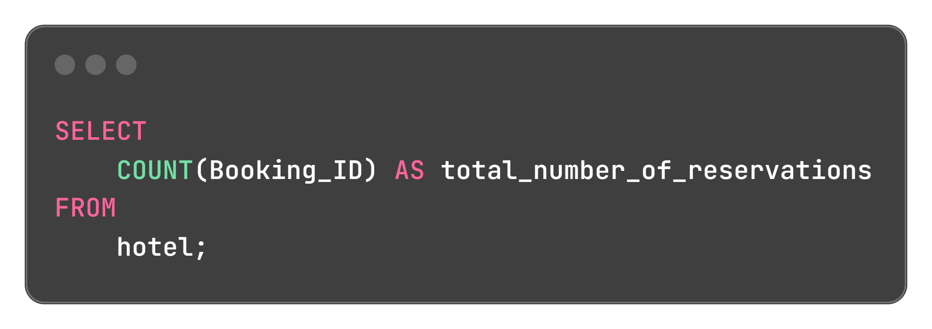

QUERY AND IT’S RESULT
QUERY
RESULT
Interpretation
This indicates the dataset contains 700 hotel reservations, providing a robust sample size for analysis.

Slide 8
QUERY
02
Which meal plan is the most popular among guests?

Slide 9
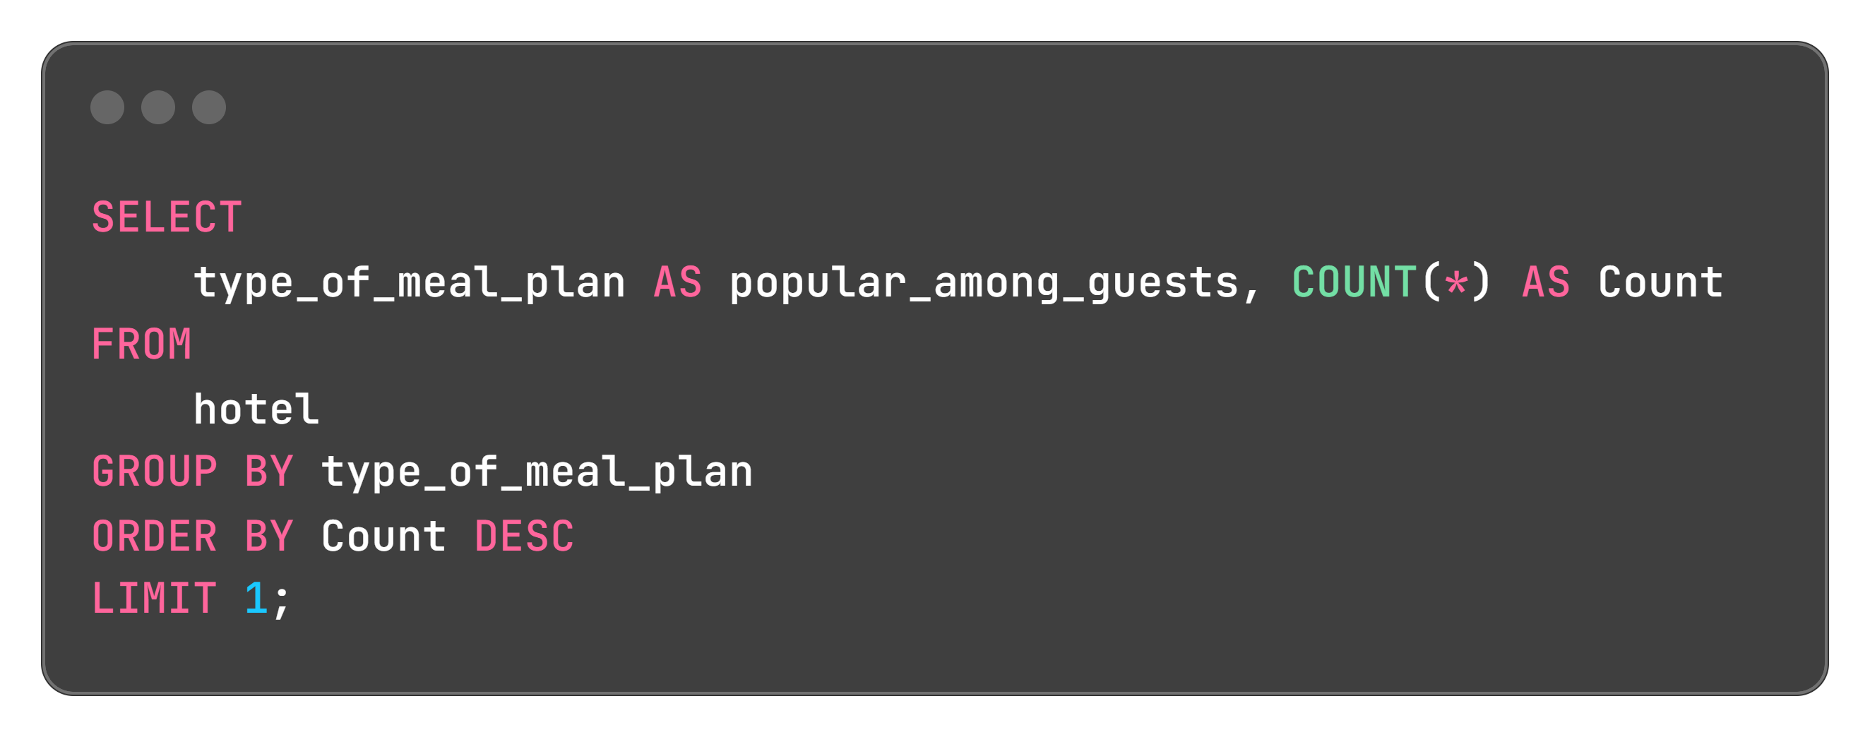

QUERY AND IT’S RESULT
QUERY
RESULT
Interpretation
Meal plan 1 is the most popular among guests.

Slide 10
QUERY
03
Average Price Per Room for Reservations Involving Children

Slide 11
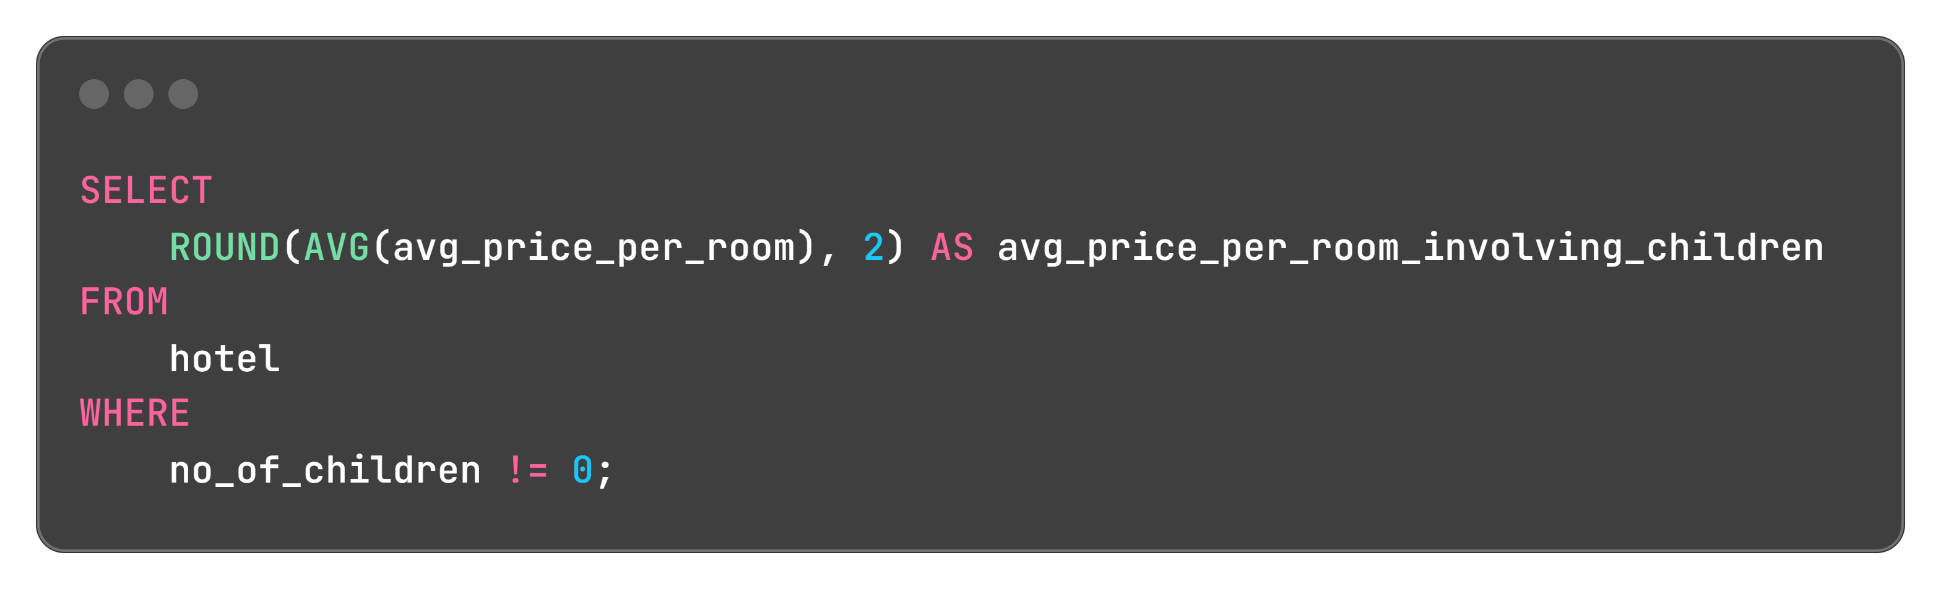

QUERY AND IT’S RESULT
QUERY
RESULT
Interpretation
Average Price Per Room for Reservations Involving Children is 144.57

Slide 12
QUERY
04
How many reservations were made for the year 20XX

Slide 13
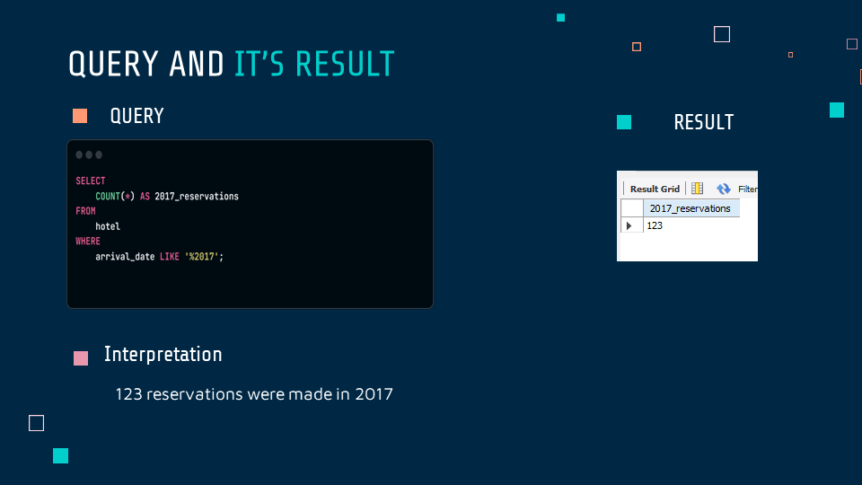

Slide 14
QUERY
05
What is the most_commonly_booked room type?

Slide 15
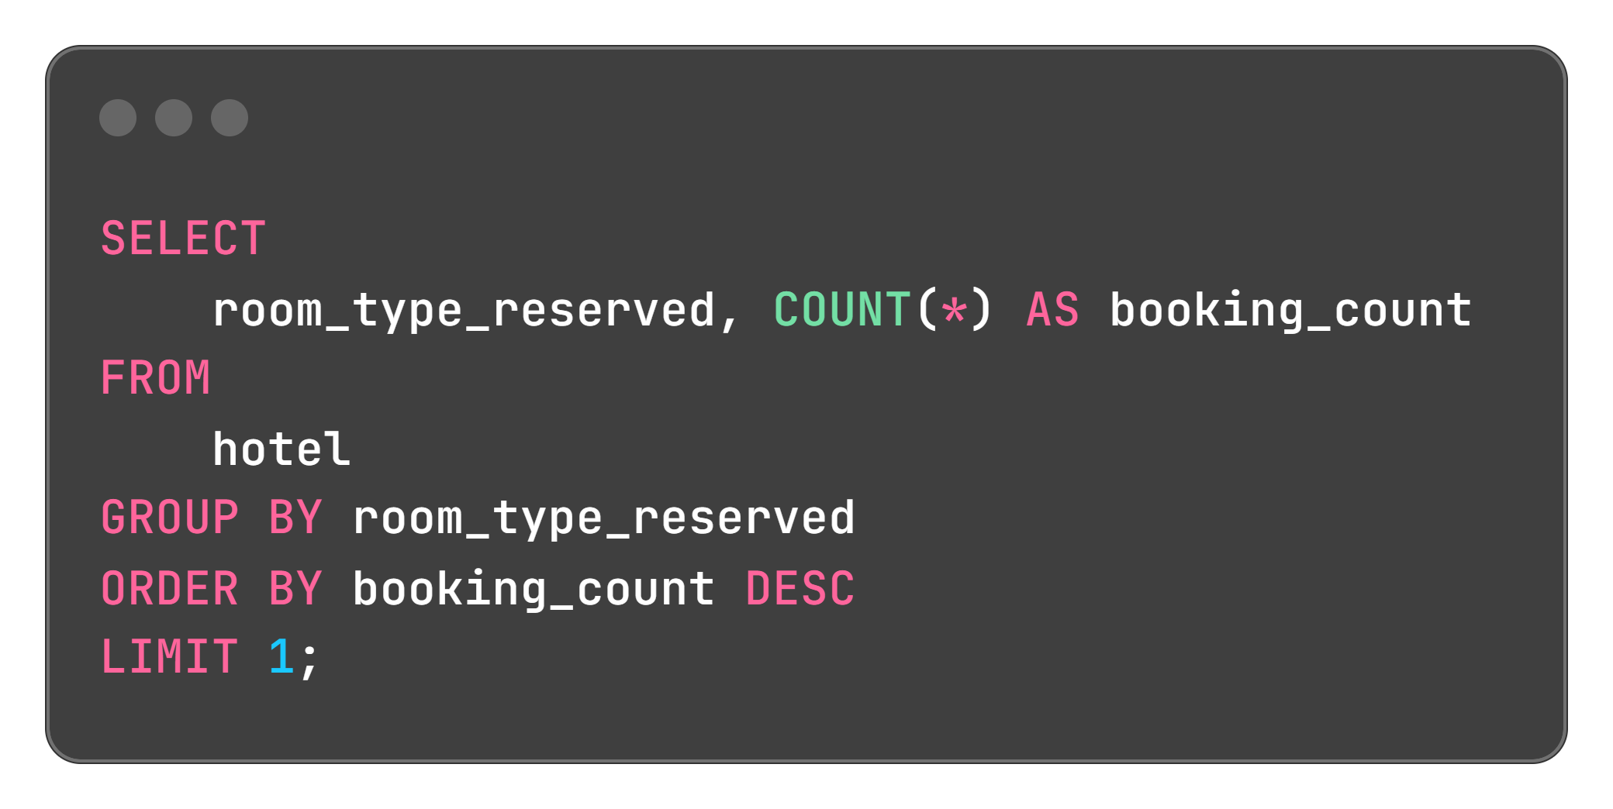

QUERY AND IT’S RESULT
QUERY
RESULT
Interpretation
Room type 1 is the most commonly booked.

Slide 16
QUERY
06
How many reservations fall on a weekend?

Slide 17
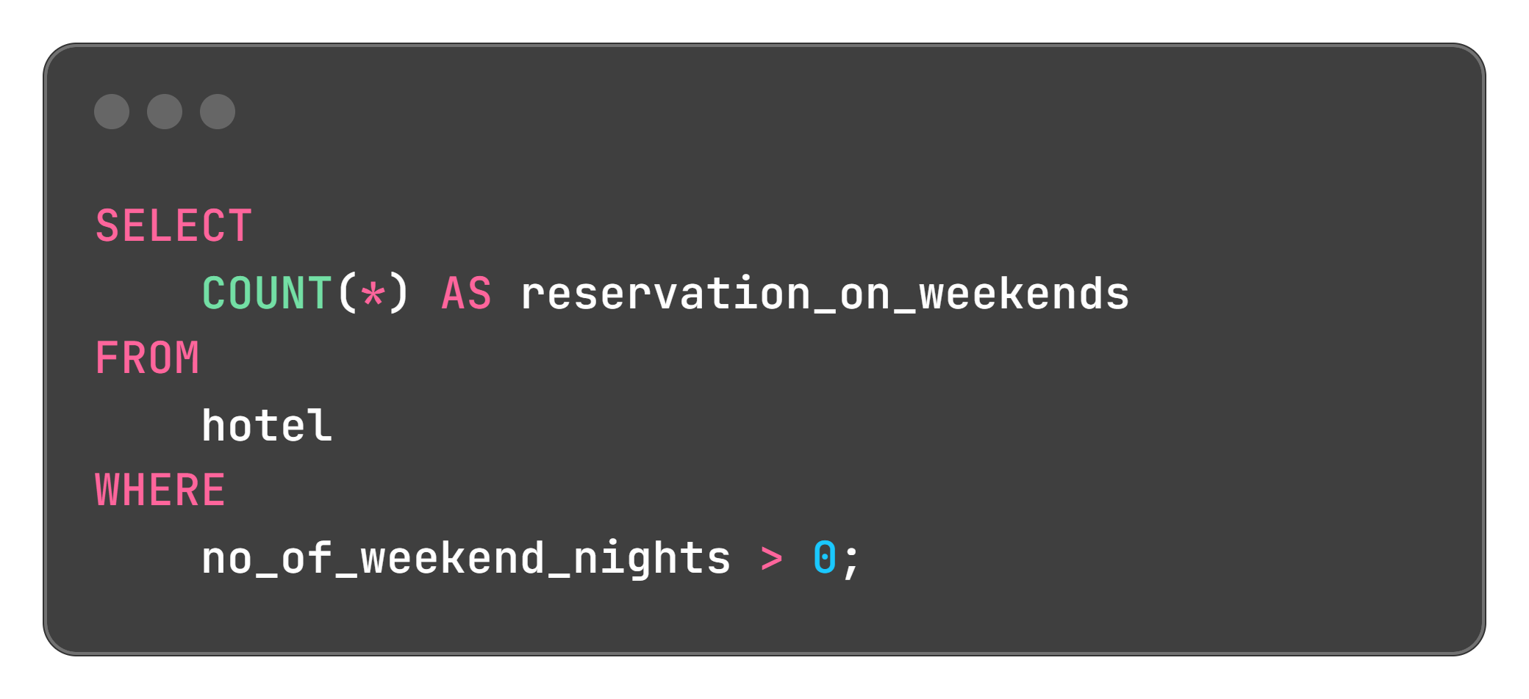
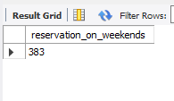
QUERY AND IT’S RESULT
QUERY
RESULT
Interpretation
Reservations fall on a weekends are 383

Slide 18
QUERY
07
What is the highest and lowest lead time for reservations?

Slide 19
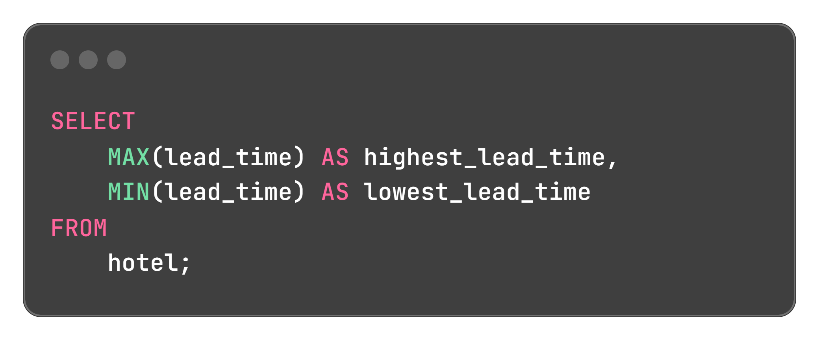

QUERY AND IT’S RESULT
QUERY
RESULT
Interpretation
The highest and lowest lead time for reservations are 443 and 0 repecctively

Slide 20
QUERY
08
What is the most common market segment type for reservations?

Slide 21
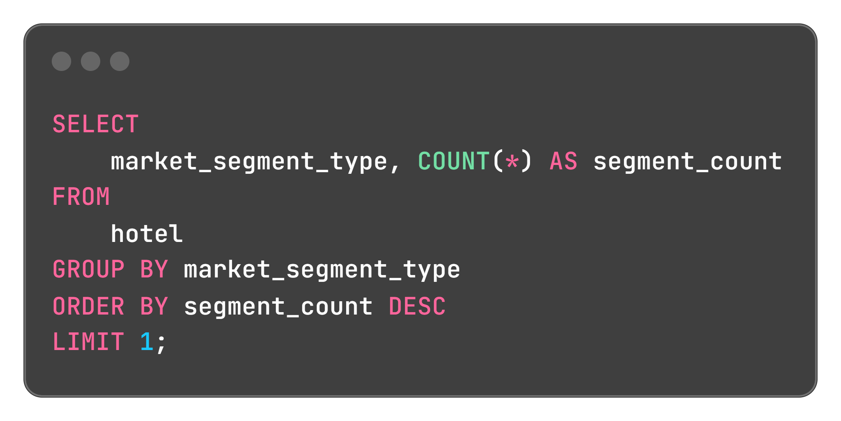

QUERY AND IT’S RESULT
QUERY
RESULT
Interpretation
The most common market segment type for reservations is “Online”

Slide 22
QUERY
09
How many reservations have a booking status of "Confirmed"?

Slide 23
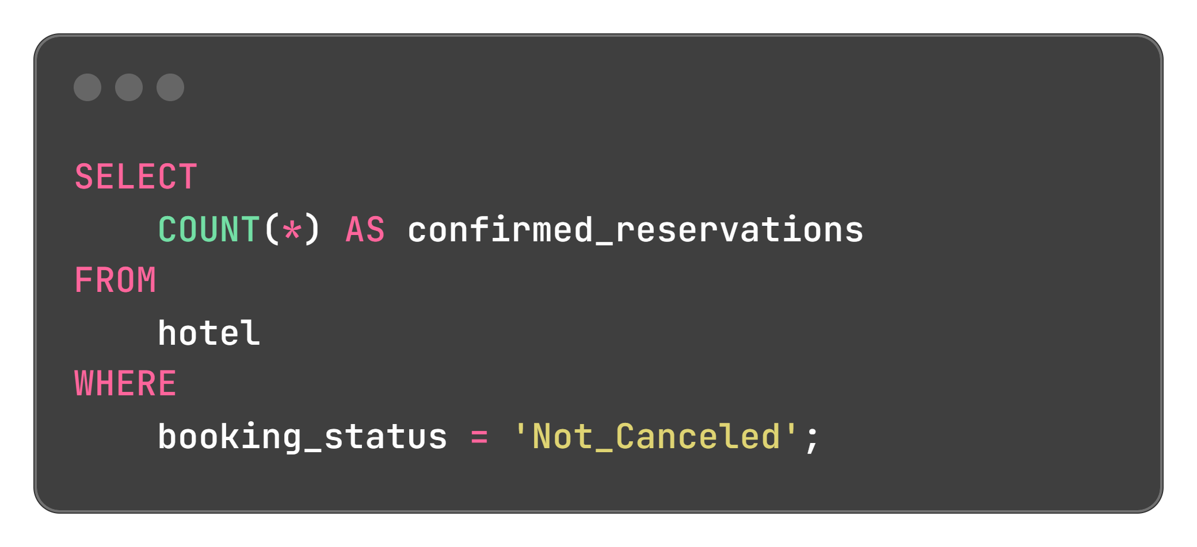
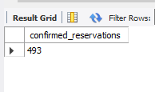
QUERY AND IT’S RESULT
QUERY
RESULT
Interpretation
Reservations have a booking status of "Confirmed“ are 493

Slide 24
QUERY
10
What is the total number of adults and children across all reservations?

Slide 25
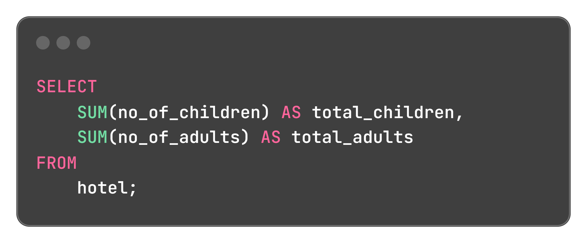

QUERY AND IT’S RESULT
QUERY
RESULT
Interpretation
The total number of adults and children across all reservations are 69 and 1316 respectively.

Slide 26
QUERY
11
What is the average number of weekend nights for reservations involving children?

Slide 27
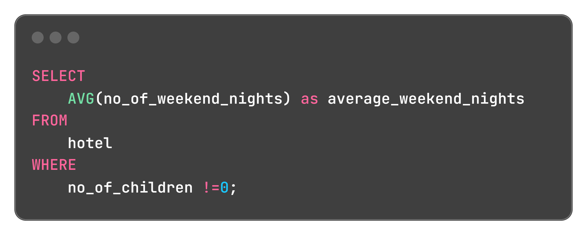

QUERY AND IT’S RESULT
QUERY
RESULT
Interpretation
The average number of weekend nights for reservations involving children is 1.00

Slide 28
QUERY
12
. How many reservations were made in each month of the year?

Slide 29
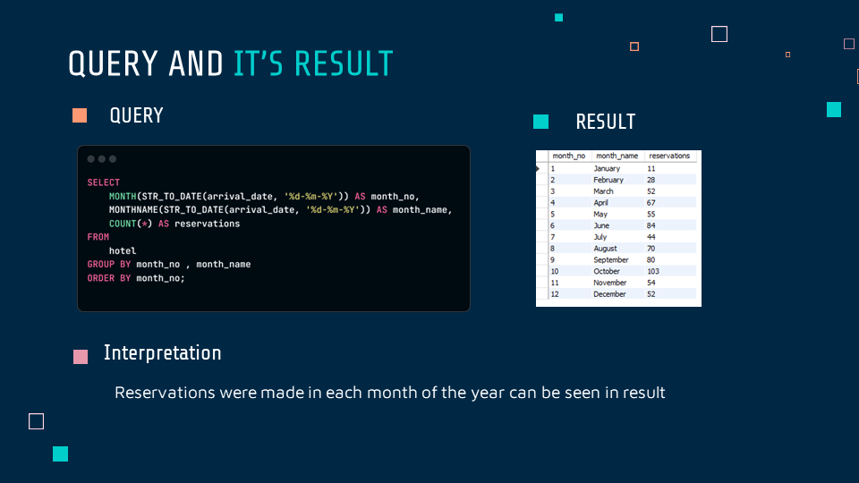

Slide 30
QUERY
13
What is the average number of nights (both weekend and weekday) spent by guests for each room type?

Slide 31
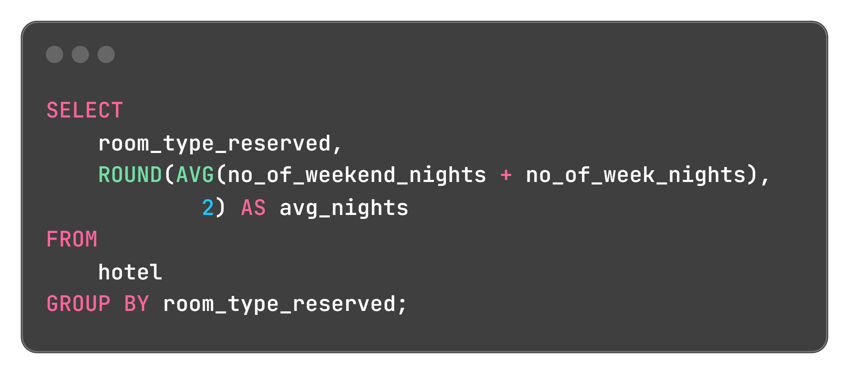
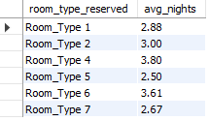
QUERY AND IT’S RESULT
QUERY
RESULT
Interpretation
The average number of nights (both weekend and weekday) spent by guests for each room type can be seen in result.

Slide 32
QUERY
14
For reservations involving children, what is the most common room type, and what is the average price for that room type?

Slide 33
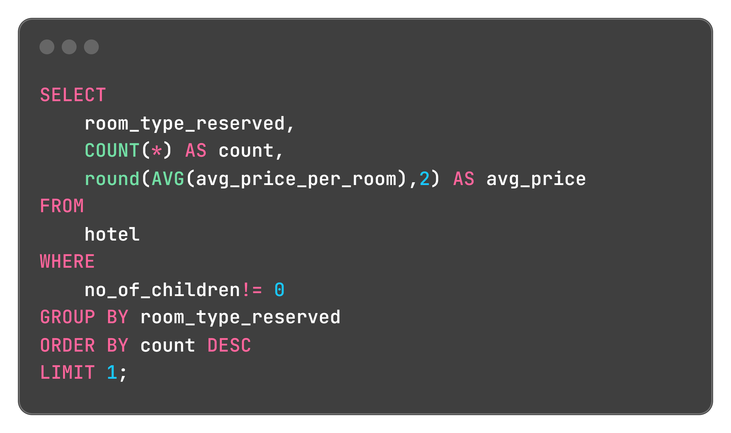
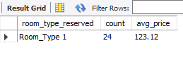
QUERY AND IT’S RESULT
QUERY
RESULT
Interpretation
Room type 1 is the most common room type for reservations involving children having average of 123.12

Slide 34
QUERY
15
Find the market segment type that generates the highest average price per room.

Slide 35
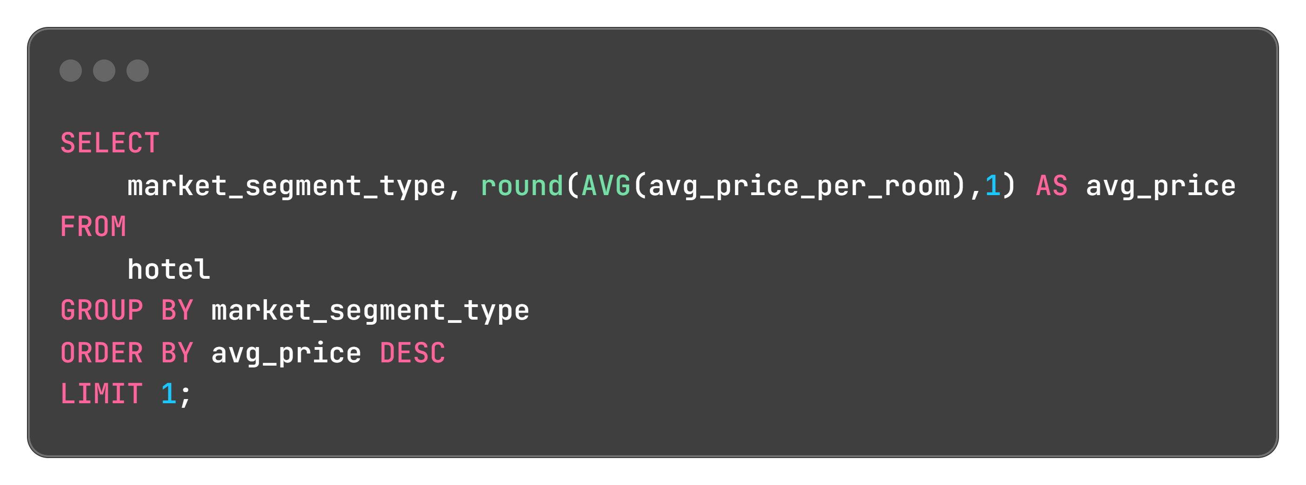

QUERY AND IT’S RESULT
QUERY
RESULT
Interpretation
The market segment type that generates the highest average price per room is Online

Slide 36
THANKS

